Slide 1

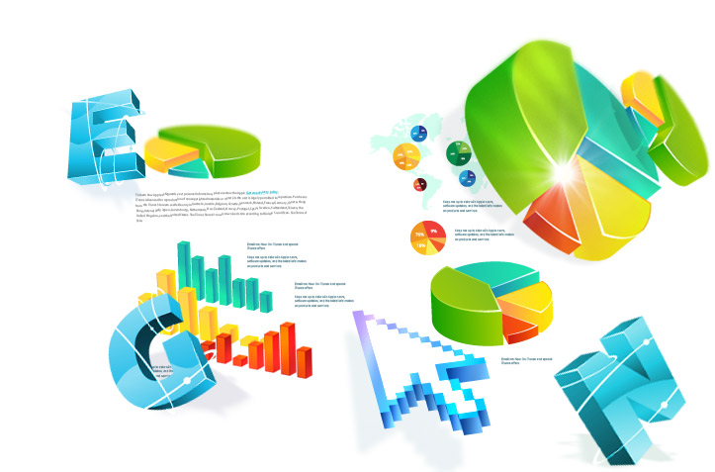

3D Trends
3D market trends
www.presente3D.com

Slide 2
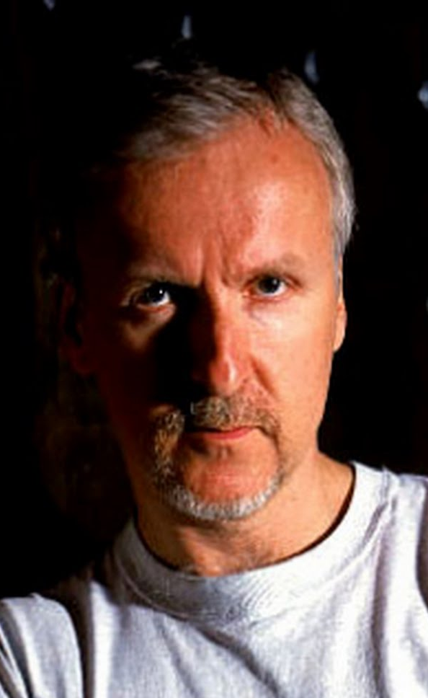

3D gives me the power to take you places you've never been before, in a way you will never forget. This is why I love 3D.
James Cameron

Slide 3
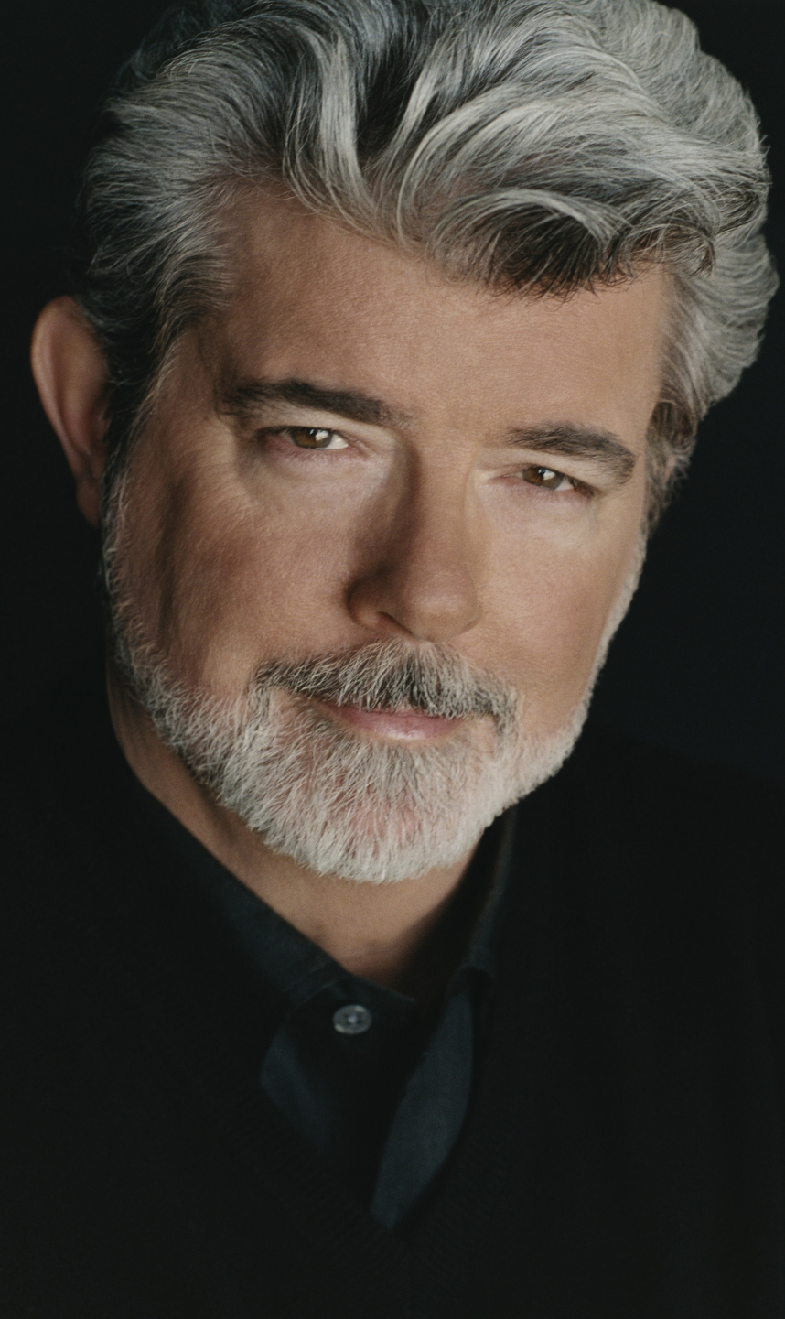

When you (watch) a (2D) movie it’s like watching in black & white. 3D is a better way of looking at a film. I totally believe that 3D will completely take over just like color did
George Lukas

Slide 4

Worldwide 3D TV forecast
6 millions 3D TV’s sold in China in 2011
Price moves downward 50%
Major brands will sell only 3D-Ready TV’s

Slide 5

Worldwide 3D TV forecast

Slide 6
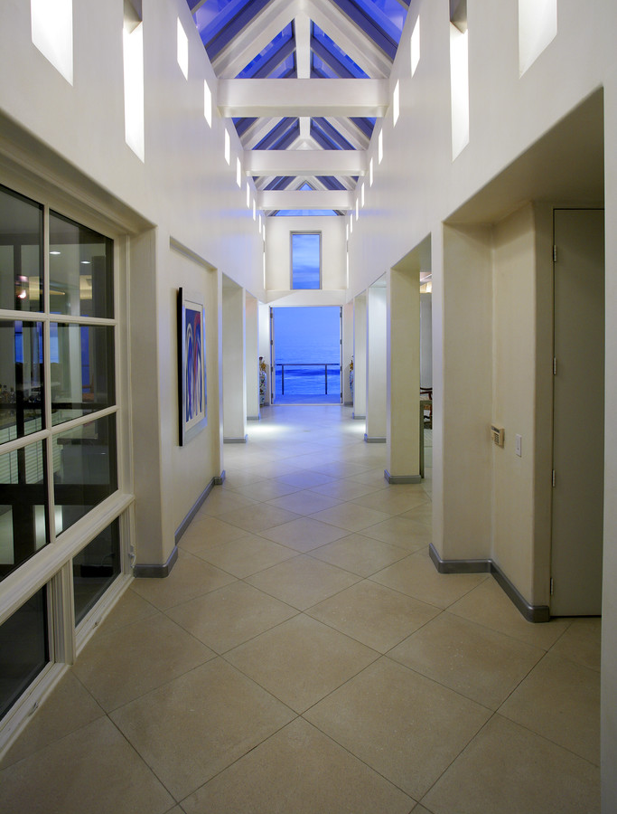

People like 3D
56% very satisfied
49% want more programs
46% want more games
*Park Assoc. Survey, 600 3DTV owners
June 2012

Slide 7


Advertising
“ … In strategic preparation for 7-series, we googled “experience” and “technology” … and 3D came up”

Slide 8


Apple
Apple is working on ground breaking glasses-free 3D display that (according to insider) will reinvent the way consumers perceive 3D.
*By Daryl Deino, LA gadgets Examiner

Slide 9


Customer interest
“3D” is googled more than 88 million times per month

Slide 10

Immersive 3D Presentations

